Slide 1
COACH Food Insecurity Training
Last updated May 2020

Slide 2
Learning Objectives
Learn about local collaboration through COACH to address food insecurity.
Understand value of incorporating an understanding of patient social needs into care.
Gain background on food insecurity and its impact on health.
Understand how to screen for food insecurity and how your institution is intervening to address positive screens.
Based on your role, learn specific ways that you and others on your team can help to identify food insecurity and get patients the food they need to lead healthy lives.

Slide 3
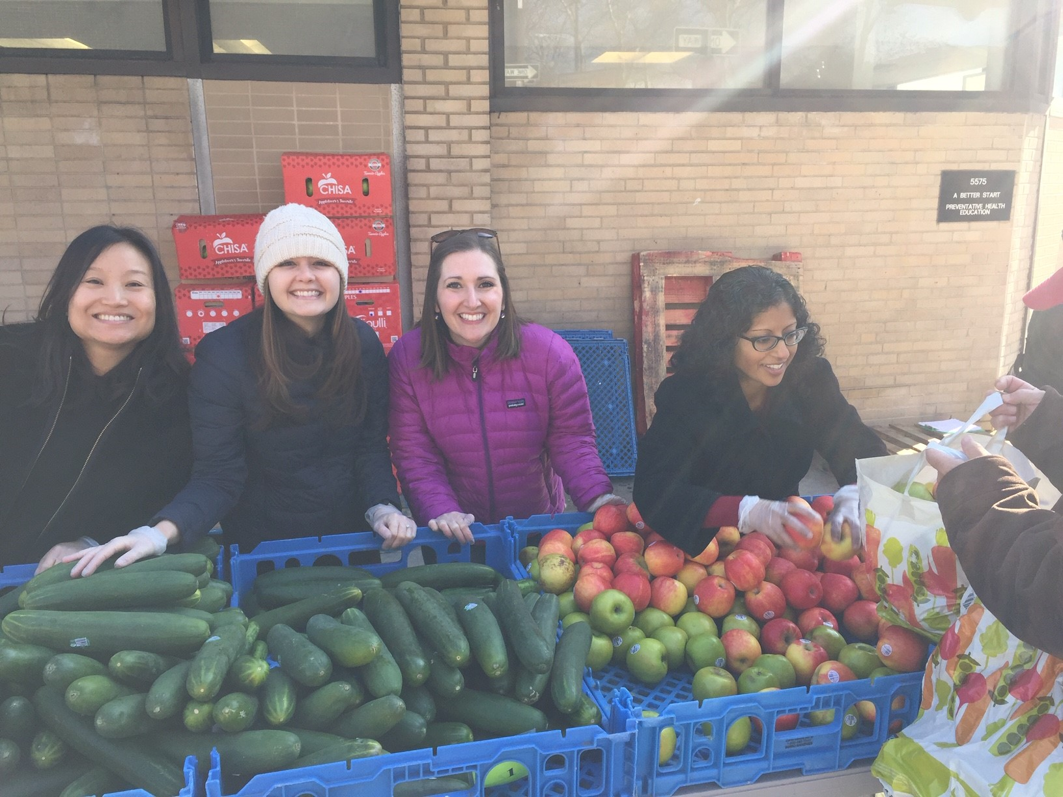
COACH & Food Insecurity
Since 2017, 8 health systems in Greater Philadelphia have been working on a shared implementation strategy to address food insecurity through Collaborative Opportunities to Advance Community Health (COACH).
These health systems are screening for food insecurity in varied clinical sites and responding to needs with referrals to resources and interventions such as pop up markets and summer meal programs.
Through COACH’s Food Insecurity Workgroup, health systems and food access partners:
Coordinate programming
Share best and emerging practices
Carry out data collection and dissemination projects.
(L-R) Susan Choi, Kelsey Salazar, Danielle Cullen (Food Insecurity Workgroup chair), Kinnari Chandriani at Einstein Medical Center Philadelphia’s Fresh for All free produce market in 2019
Notes:
8 health systems: Abington Jefferson Health, CHOP, Einstein, Holy Redeemer, Jefferson, Penn, Temple, Trinity
Food insecurity identified as a priority due to its prevalence in Philadelphia and association with poor health. Health systems across the country are focusing on food insecurity, and the movement toward value-based payment is catalyzing these efforts.
Our Food Insecurity Workgroup chair is Danielle Cullen, an emergency department physician at CHOP and researcher at PolicyLab.
Remember, the work that you’re doing is part of a larger effort across the Greater Philadelphia area to fight hunger in our communities.

Slide 4
Training Approach
This training, a product of the Food Insecurity Workgroup, distills the latest research, toolkits, and best practices into a flexible training framework.
The training is organized around 4 modules:
Module 1: Social Needs & Their Impact
Module 2: Background on Food Insecurity
Module 3: Identifying & Addressing Food Insecurity in Healthcare Systems
Module 4: Role-Based Guidance for Healthcare Systems
All team members at a site should complete as many module(s) as appropriate, based on their familiarity with the content and their role in the site’s food insecurity project.
Organizations are encouraged to customize the slides with details of their specific plans for screening and intervention.

Slide 5
Module 1: Social Needs & Their Impact

Slide 6
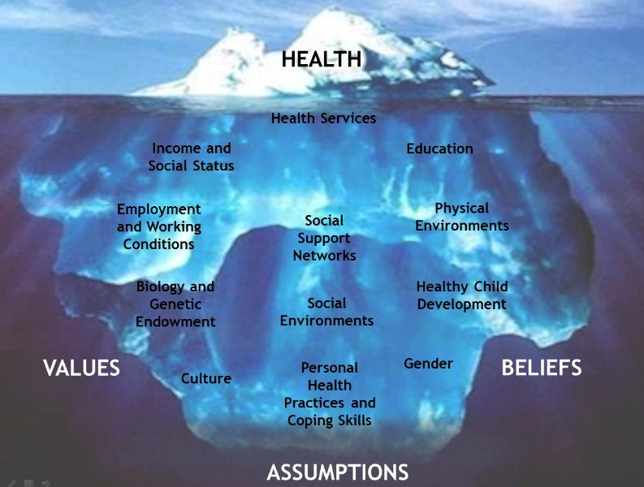
Beyond the Tip of the Iceberg
http://en.healthnexus.ca/topics-tools/health-equity-topics/social-determinants-health
Notes:
The opportunity for health begins—long before illness—in homes, neighborhoods, communities, schools, jobs.
John Travis and Regina Ryan (1998)
The top section represents physical health status that is immediately visible, identifiable and often measurable. This “tip of the iceberg” shows only a small part of the overall picture.
The middle section identifies the behavioural and lifestyle factors that contribute to health “just under the water’s surface”
The bottom section represents the social determinants which have the greatest impact on health status and influence the opportunities, exposures, and behaviours that contribute to health. These make up the bulk of the health iceberg and are not always immediately obvious, but have the potential to offer the biggest gains.

Slide 7
Clarifying Key Terms
Example Action
Term
Definition
Social determinants of health
Social risk factors
Social needs
Adverse social conditions associated with poor health, assessed at individual patient level (e.g., food insecurity, housing instability)
The conditions in which people are born, grow, live, learn, work, play, and age
Immediate needs that takes into account patient preferences and priorities
Advocating for policies that improve communities’ underlying social and economic conditions
Screening for food insecurity or housing instability in clinical settings
Connecting patients to resources for needs identified as priorities and for which they request help
https://www.milbank.org/quarterly/articles/meanings-and-misunderstandings-a-social-determinants-of-health-lexicon-for-health-care-systems/
Notes:
It is worth taking a moment to clarify a few important terms that are often used interchangeably but are distinct. Precision with these terms helps to hone in on and clarify the target and content of interventions.
SDOH impact everyone – they are not something that a person can have or not have, and they are not positive or negative. Acting to address SDOH means trying to improve the underlying conditions in which people are born, grow, live, learn, work, play, or age.
Social risk factors are negative conditions that contribute to poor health and assessment is done at the individual patient level.
Social needs are immediate and involve individual patients’ preferences and priorities for what they would like to get help with.

Slide 8
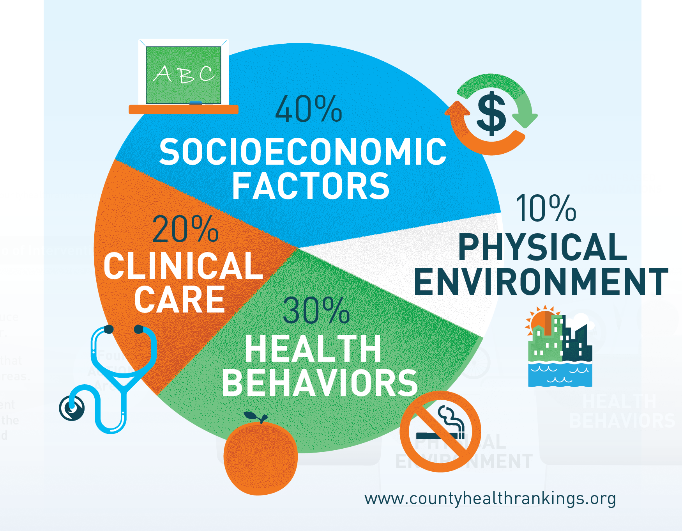
Relative Contributions to Health
http://www.cdc.gov/chinav/docs/chi_nav_infographic.pdf
Notes:
Health is complex, influenced by the health care we receive, our own choices, and our communities.
These estimates of relative contribution of modifiable factors is based on the County Health Rankings model. As you can see, some modifiable factors impact health more than others.
Clinical care alone is not enough to improve health. Although medical care is essential for relieving suffering and curing illness, 80% of the things that can help make us healthy are not part of the health care system. Given this, the proposal that health systems across the country are embracing is that we devote our collective attention and energy to that 80%.

Slide 9
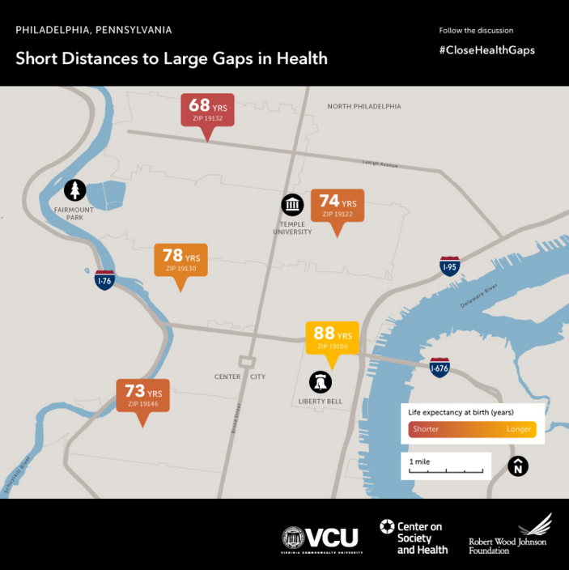
Life Expectancy: Place Matters
http://www.rwjf.org/en/library/infographics/life-expectancy-maps.html
Notes:
…Because it’s a matter of life and death.
For babies born within 4 miles of Center City Philadelphia, opportunities to lead a long and healthy life can vary dramatically. Note the striking 20 year difference between North Philadelphia and Old City…
Why the gap? Good health outcomes are related to such things as access to nutritious food, safe and walkable streets, active playgrounds and public spaces, good jobs, educational opportunities and stable housing.
Maps of cities across the country show that the same communities have low incomes and low educational attainment, as well as higher rates of obesity, diabetes, tobacco use, preventable hospitalizations, adverse childhood experiences, and frequent mental distress. There’s a great deal of research demonstrating the association between social risk factors and these adverse outcomes.

Slide 10
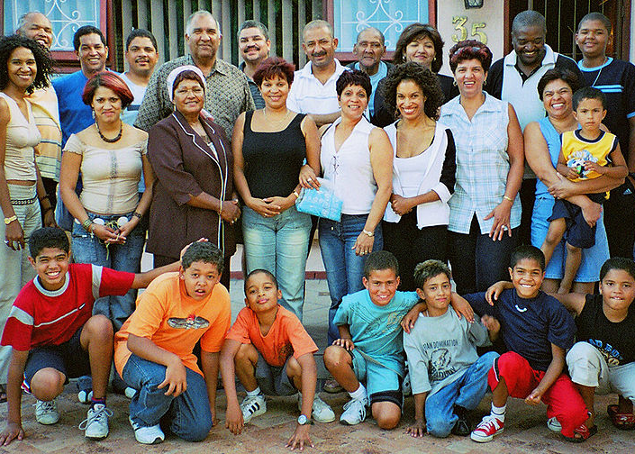





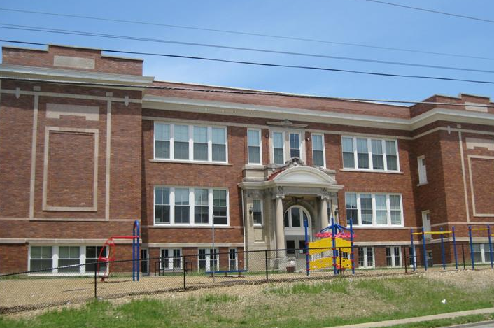
Our Patients in Context
Notes:
So it’s really important to look at our patients in context. They are a lot more than how they present in our hospitals and offices. Going back to the iceberg analogy, what you see on the surface is only a fraction of who they are. They come with a whole host of beliefs, knowledge, motivations, hopes, fears, all colored by their circumstances and life experiences/history—by their education, workplaces, their schools, their homes, neighborhoods, and family support networks.
To delve deeper with our patients, we need empathy and a desire to know them as a whole person, go beyond the visible and stated. As a Cleveland Clinic video on empathy asks: “If you could stand in someone else's shoes . . . hear what they hear. See what they see. Feel what they feel. Would you treat them differently?” If you knew what they were thinking and experiencing outside of the hospital, would you care for them differently?

Slide 11
Social Needs: Patient Perspectives
A 2019 survey¹ of over 1,000 U.S. adults found:
One-third experience stress related to meeting basic needs, such as housing, food, and transportation.
Among families at the highest income levels ($125k+), 40% reported at least one unmet social need in the past year.
97% of respondents said that medical providers should ask about social needs during visits.
¹ Kaiser Permanente. Social Needs in America. Accessed at: https://about.kaiserpermanente.org/content/dam/internet/kp/comms/import/uploads/2019/06/KP-Social-Needs-Survey-Key-Findings.pdf
Notes:
Taking into account patients’ contexts is particularly important in light of recent data that suggests that many of our patients experience significant unmet social needs.

Slide 12
Signs of Unmet Social Needs
Some red flags…do they sound familiar?
The “non-compliant” patient
The stressed patient with a seeming lack of engagement with care
Children with failure to thrive
Repeated utilization of emergency rooms for chronic uncontrolled conditions
Prolonged illness or persistent minor health problems
Notes:
These unmet needs show up in ways that you might recognize from your own patients.

Slide 13
Consequences of Unaddressed Needs
Limited therapeutic efficacy, as patients may be unable to adhere to treatment and recommendations
Missed opportunity to build trust and take a holistic approach to care that can help build sustained patient engagement
Limited impact on the most vulnerable populations, whose social needs worsen clinical needs
Notes:
You have probably experienced yourselves that leaving these “elephants in the room” unaddressed leads to the following.

Slide 14
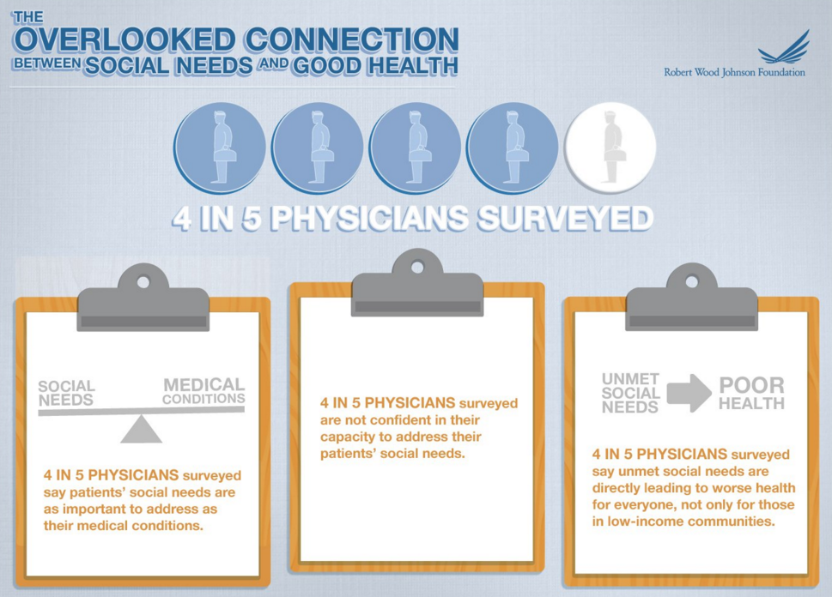
Social Needs: Physician Views
http://www.rwjf.org/en/library/research/2011/12/health-care-s-blind-side.html
Notes:
Clinicians see the unmet needs and their impacts firsthand. This is reflected in physicians’ views of social needs from the 2011 Physicians’ Daily Life Report/Health Care’s Blind Side report funded by the Robert Wood Johnson Foundation.
Supplemental Information
Consistent with this, in 2018, the American College of Physicians released a position paper on social determinants of health that attests to the importance of understanding and addressing social factors that influence health: https://annals.org/aim/fullarticle/2678505/addressing-social-determinants-improve-patient-care-promote-health-equity-american

Slide 15
Social Needs: System Forces
Shift to value-based reimbursement increases accountability for health care providers/ organizations for patient health and cost outcomes, incentivizing greater attention to unmet social needs.
Medicaid Managed Care Organizations and Accountable Care Organizations are increasingly requiring screening for social needs.

Slide 16
Social Needs: Health System Activities
A 2017 survey of hospitals found that 88% screened at least some of their patients for social needs.¹
Between 2017 and 2019, health systems publicly committed ~$2.5 billion to addressing social needs, with the largest investments in housing, employment, and food security.²
¹ Deloitte. Social determinants of health: How are hospitals and health systems investing in and addressing social needs? Accessed at: https://www2.deloitte.com/content/dam/Deloitte/us/Documents/life-scienceshealth-care/us-lshc-addressing-social-determinants-of-health.pdf
² Horwitz LI, Chang C, Arcilla HN, Knickman JR. Quantifying health systems investment in social determinants of health, by sector, 2017-19. Health Aff (Millwood. 2020;39(2):192-198.
Notes:
Consequently, health systems are increasingly recognizing the high prevalence of unmet social needs and the consequences of not addressing them. The growing attention on social needs is reflected in screening activities and investments in interventions to address them.

Slide 17
Addressing Social Needs is Effective
Examples of research on specific interventions:
Housing: Improved health outcomes related to obesity and diabetes¹ and asthma,² lowered health care spending³
Food support: Lower healthcare utilization and health care costs,^{4,5} reduction in HbA1c⁵
Income support: Reduced infant mortality,⁶ lower odds of acute hospitalization after emergency department visit⁷
¹ Ludwig J, Duncan GJ, Gennetian LA, Katz LF, Kessler RC, Kling JR, et al. Neighborhood effects on the long-term well-being of low-income adults. Science. 2012; 337(6101):1505-10.
² Garland E, Steenburgh ET, Sanchez SH, Geevarughese A, Bluestone L, Rothenberg L, et al. Impact of LEED-certified affordable housing on asthma in the South Bronx. Prog Community Health Partnersh. 2013; 7(1):29-37.
³ Larimer ME, Malone DK, Garner MD, Atkins DC, Burlingham B, Lonczak HS, et al. Health care and public service use and costs before and after provision of housing for chronically homeless persons with severe alcohol problems. JAMA. 2009;301(13):1349-57.
⁴ Berkowitz SA, Terranova J, Hill C, Ajayi T, Linsky T, Tishler LW, et al. Meal delivery programs reduce the use of costly health care in dually eligible Medicare and Medicaid beneficiaries.) Health Aff (Millwood. 2018;37(4):535-542.
⁵ Hess A, Passaretti M, Coolbaugh S. Fresh Food Farmacy. Am J Health Promot. 2019;33(5):830-832.
⁶ Arno PS, Sohler N, Viola D, Schechter C. Bringing health and social policy together: the case of the earned income tax credit. J. Public Health Policy. 2009;30(2):198-207.
⁷ Frank DA, Neault NB, Skalicky A, Cook JT, Wilson JD, Levenson S, et al. Heat or eat: the Low Income Home Energy Assistance Program and nutritional and health risks among children less than 3 years of age. Pediatrics. 2006; 118(5):e1293-302.
Notes:
This is just a small slice of the growing research base that demonstrates that specific interventions such as providing housing, medically tailored meals, fresh produce boxes, Earned Income Tax Credit, and the Low Income Home Energy Assistance Program (LIHEAP) can make a difference in patients’ health and their use of the health care system.

Slide 18
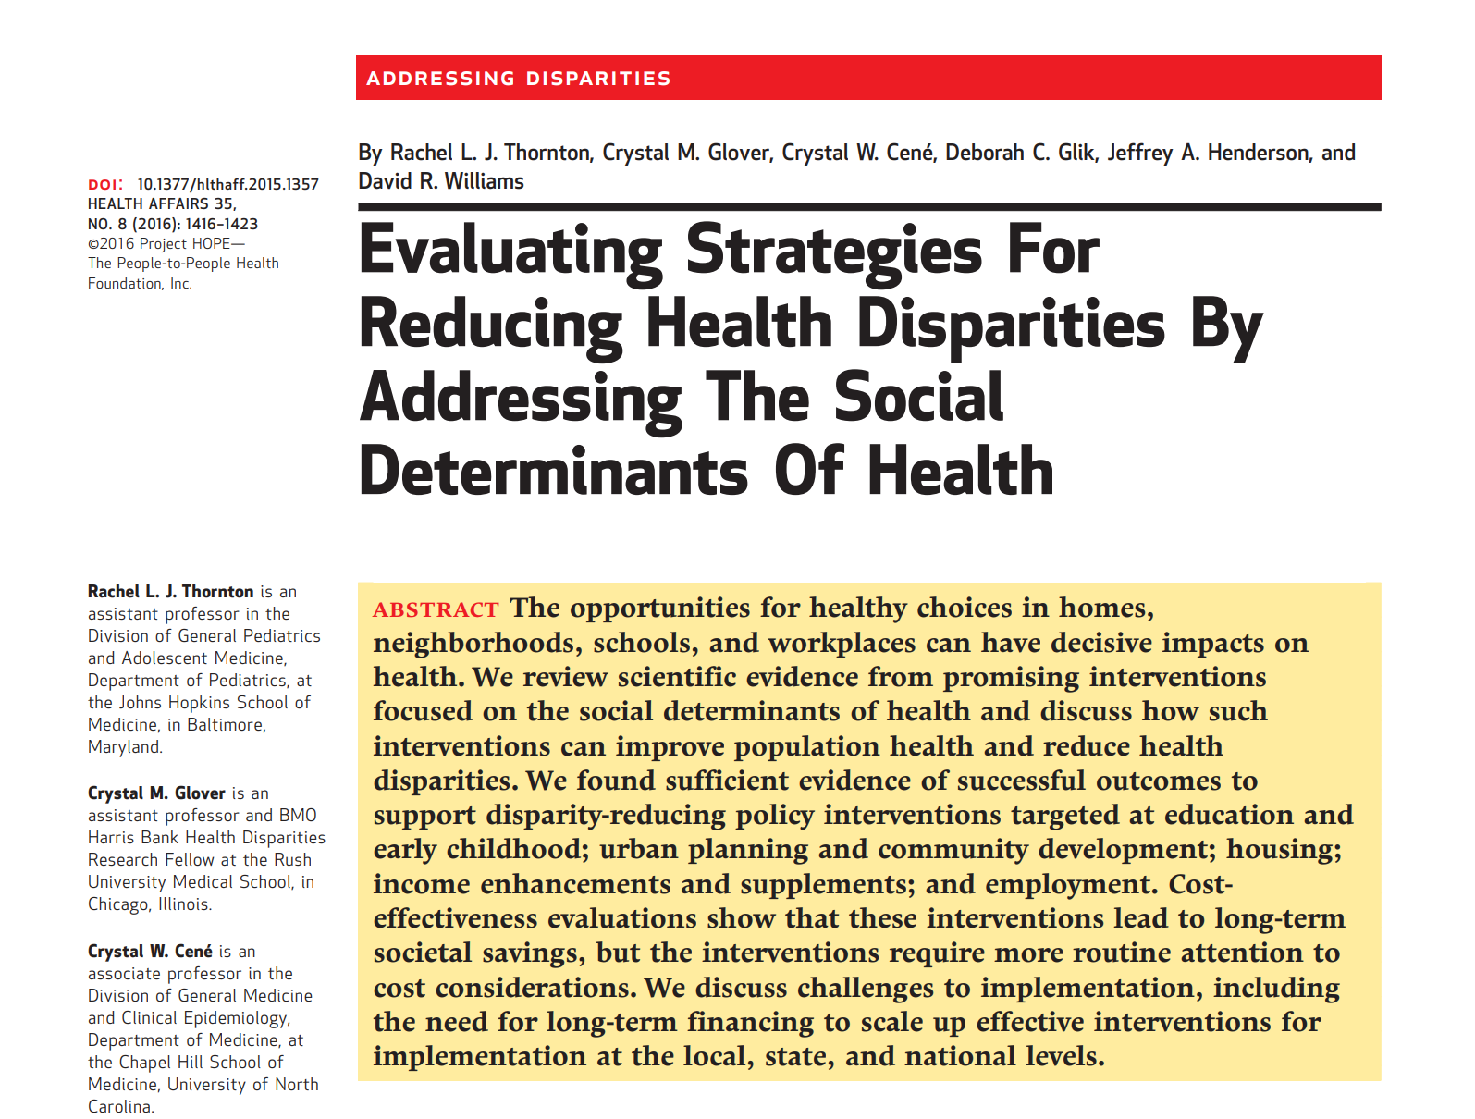
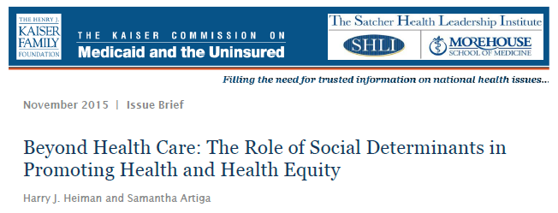
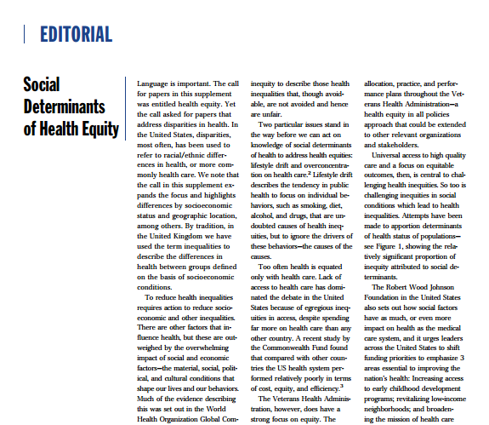

Towards Health Equity
A focus on social determinants of health and social needs presents pathways to achieving health equity.
Notes:
As Sir Michael Marmot, a foundational researcher on social determinants of health, puts it, the “unequal distribution of health-damaging experiences” to certain social groups are a key cause of health disparities.
These are a sample of articles and resources representative of the work that tie SDOH and health equity. A focus on SDOH and social needs provides one pathway towards addressing health disparities and ultimately promoting health equity.

Slide 19
[Placeholder for Strategic Priorities]
[List your organization’s strategic priorities that align with a focus on patient social needs]
Notes:
[Some possibilities to consider: hospital’s role as an anchor institution, improved patient experience, increased patient safety, improved patient outcomes, emphasis on patient-centered care, alignment with community health needs assessment, advancement of racial equity]

Slide 20
Module 2: Background on Food Insecurity

Slide 21
What is Food Insecurity?
The lack of consistent access to enough food for an active, healthy life.
Household-level economic and social condition of limited or uncertain access to adequate nutritious food.
Food insecurity is often invisible and hidden.
There is no single face of food insecurity.
1 in 8 U.S. households were food insecure in 2017.
Food insecurity affects ALL communities in the U.S.
Sources: USDA, Feeding America
Notes:
Food insecurity is associated with poverty, unemployment, scarcity of household assets.
Families can be considered food insecure if they experience anxiety about having enough food in the house, have to purchase lower quality, lower variety, or less desirable food, have to eat less or less often.
In these households, members unwillingly go without food occasionally or cyclically, such as at the end of a pay period or during peak fuel months. Summer months may be worse for children who are not receiving school meals.

Slide 22

What It’s Like
https://youtu.be/J2dOKcBgGi4
Notes:
[This may look like a blank black screen but in slideshow mode you will be able to click and play the video directly in PowerPoint.]
This video features participants of Witnesses to Hunger, a project started by Mariana Chilton at Drexel University’s Center for Hunger-Free Communities.
“Started in Philadelphia in 2008, Witnesses to Hunger is a research and advocacy project partnering with the real experts on hunger—mothers and caregivers of young children who have experienced hunger and poverty. Through their photographs and stories, Witnesses advocate for their own families and others and seek to create lasting changes on a local, state and national level.”
To learn more:
https://www.centerforhungerfreecommunities.org/our-programs/witnesses-hunger

Slide 23
“Food is Medicine”
The purpose of “Food is Medicine” efforts is to provide food that is tailored to those with acute or chronic illness or disability.
Food insecurity interventions are distinct from “Food is Medicine” interventions.
Interventions to address food insecurity are broad-based and deployed regardless of severity of illness or symptoms.
Notes:
From Massachusetts Food is Medicine State Action Plan (2019):
“Food is Medicine refers to a spectrum of services and health interventions that recognize and respond to the critical link between nutrition and chronic diseases” [or serious acute illness - added by HCIF]. Food is Medicine interventions consist of healthy foods that are tailored to meet the specific needs of individuals living with or at risk for serious health conditions affected by diet.”
This distinction is important in terms of considering appropriate deployment of resources. For example, some food resources may not be available to your patients due to eligibility criteria that may require that the patient have a serious medical condition or that a registered dietitian conduct an assessment of the patient’s dietary needs.
It is also important to note that the needs of the target populations for food insecurity or Food is Medicine efforts may overlap (i.e., those who may benefit from Food is Medicine interventions may also be food insecure and vice versa).

Slide 24
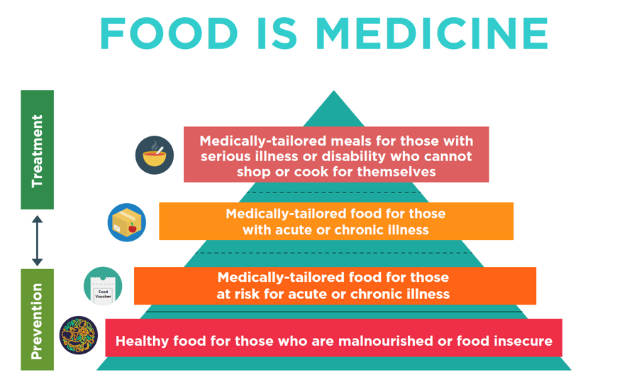
“Food is Medicine” Pyramid
http://www.fimcoalition.org/our-model
Notes:
This pyramid represents the differentiation between different types of intervention and where they fall in the spectrum of prevention to treatment of illness.
As you go down the pyramid, the interventions apply to a broader group of people. The broadest intervention looks to prevent not only illness, but food insecurity or malnourishment as well.
A local example of a provider of medically-tailored meals is MANNA.

Slide 25
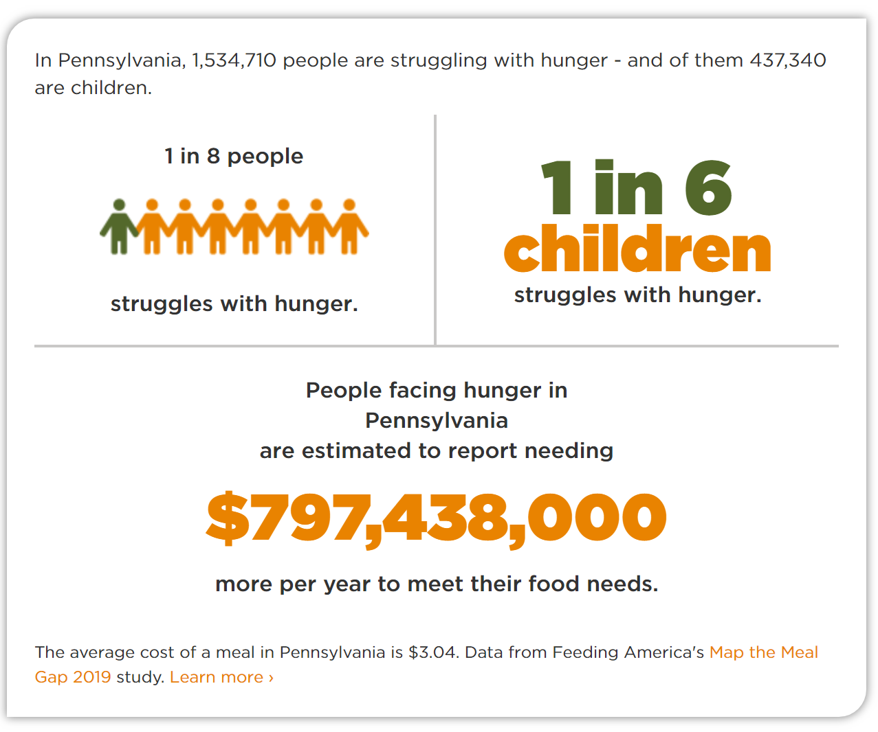

A Priority in Pennsylvania
https://www.dhs.pa.gov/about/Ending-Hunger/Documents/Setting%20the%20Table.pdf
Notes:
Given the significant need in PA, Governor Tom Wolf established the Governor’s Food Security Partnership in 2015. The blueprint sets out the goal “to provide all Pennsylvanians with access to healthy, nutritious food, which will improve their well-being, health, and independence.”

Slide 26
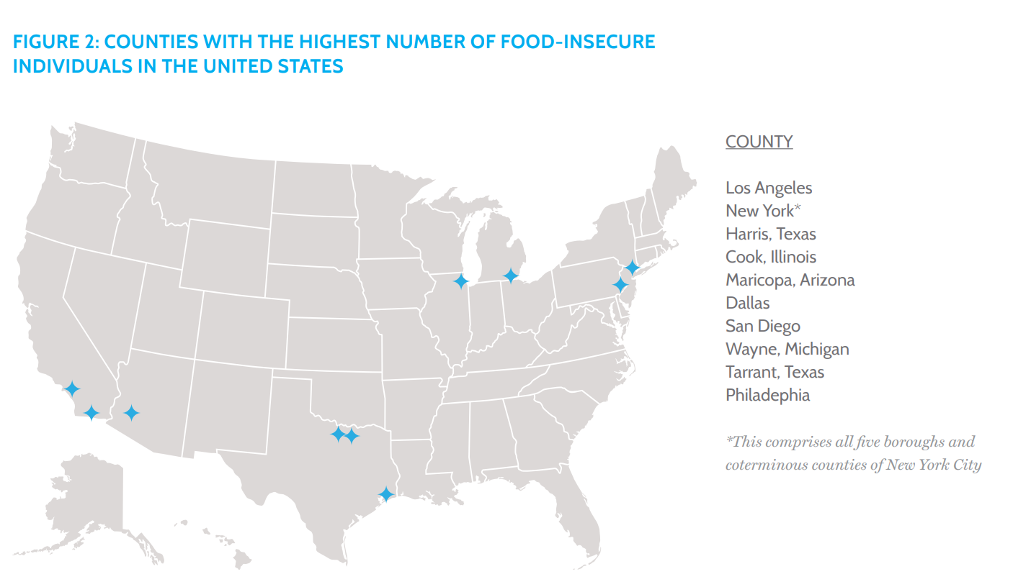
Food Insecurity in Philadelphia
1 in 5 Philadelphians—over 300,000 residents—are food insecure. (Source: Map the Meal Gap 2017, Feeding America)
l
https://essentialhospitals.org/wp-content/uploads/2016/06/Food-Insecurity-Health-Equity-Essential-Hospitals.pdf
Notes:
https://map.feedingamerica.org/county/2017/overall/pennsylvania/county/philadelphia

Slide 27
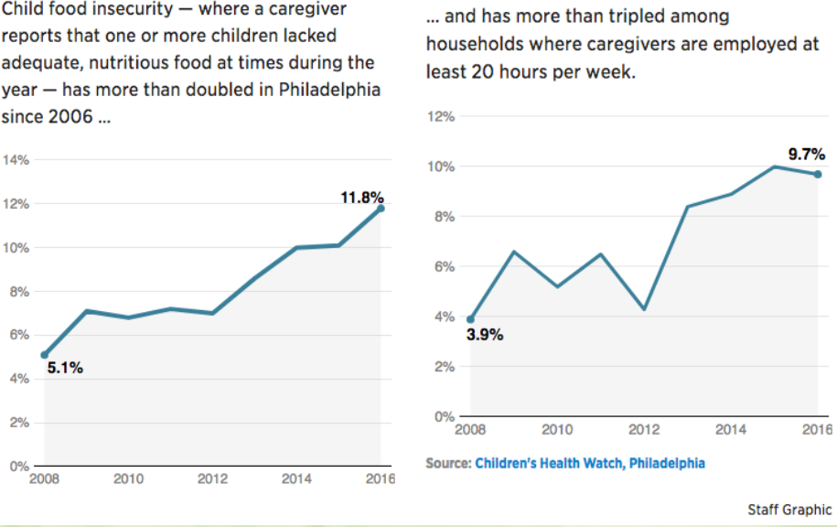
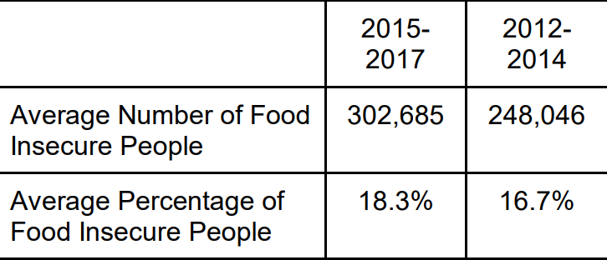
Hunger in Philadelphia is Worsening…
…despite declining rates of food insecurity across the U.S.
https://www.centerforhungerfreecommunities.org/media/news/phila-inquirer-childhood-hunger-north-philadelphia-nearly-triples
https://www.hungerfreeamerica.org/sites/default/files/atoms/files/Philadelphia%20Hunger%20Report%202018_0.pdf
Notes:
Supplemental Information
Hunger Free America report:
In the 2015-2017 time period, 302,685 residents of Philadelphia, or 18.3 percent (one in five) of the city’s total population, lived in households that were characterized by the federal government as “food insecure,” meaning they were unable to always afford sufficient food. In contrast, 248,046, or 16.7 percent, of Philadelphians were food insecure in 2012-2014. Based on this data, the number of people struggling against hunger in Philadelphia increased by 22 percent over the last six years.
239,627 adults in the Philadelphia metropolitan region were working from 2015- 2017 but were still food insecure.

Slide 28
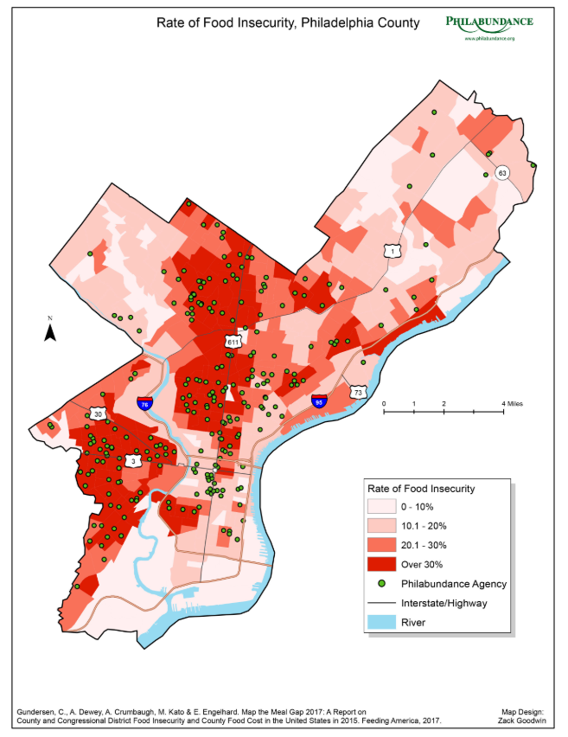
Mapping Philadelphia Food Insecurity
In large swaths of the city, food insecurity rates can exceed 30%.
Areas of high food insecurity are the same areas with high poverty.
Notes:
Map from https://www.nbcphiladelphia.com/news/local/food-insecurity-maps/216474/

Slide 29
Trauma & ACEs
Trauma results when emotionally or physically distressing external events or experiences overwhelm a person’s ability to cope and respond.
The Adverse Childhood Experiences (ACE) study and the Philadelphia Expanded ACE survey examined the prevalence and impact of household factors (e.g., having a parent with mental illness, experiencing abuse) and community-level factors (e.g., witnessing violence, feeling unsafe in your neighborhood) in large population samples.
Trauma resulting from these factors have been found to be highly prevalent, with lasting effects on individuals’ health and well-being.
Notes:
https://www.rwjf.org/en/library/infographics/the-truth-about-aces.html
https://www.philadelphiaaces.org/philadelphia-ace-survey
“Philadelphia's demographic makeup looks significantly different than the original study, in which the majority of participants were white, college-educated, and middle-income. In Philadelphia, where roughly a quarter of residents live in poverty, researchers found that almost seven in ten adults had experienced one ACE and two in five had experienced four or more.
The community-level indicators included witnessing violence, living in foster care, bullying, experiencing racism or discrimination, and feeling unsafe in your neighborhood. Researchers found that almost 40 percent of Philadelphians had experienced four or more of these expanded, community-level ACEs.”

Slide 30
Food Insecurity & Trauma
Food insecurity intersects with trauma in at least two ways:
Individuals experiencing food insecurity may be more likely to have high exposure to ACEs and may therefore be dealing with more than one form of trauma.
Experiences of stress, anxiety, fear, and feelings of hunger related to food insecurity cause trauma.
Notes:
Food insecurity itself is a form of trauma. We will be discussing this further in a later section, but important to note here that while we want to address patients’ needs, it’s important to do so in a sensitive way, or we may risk re-traumatizing patients.

Slide 31
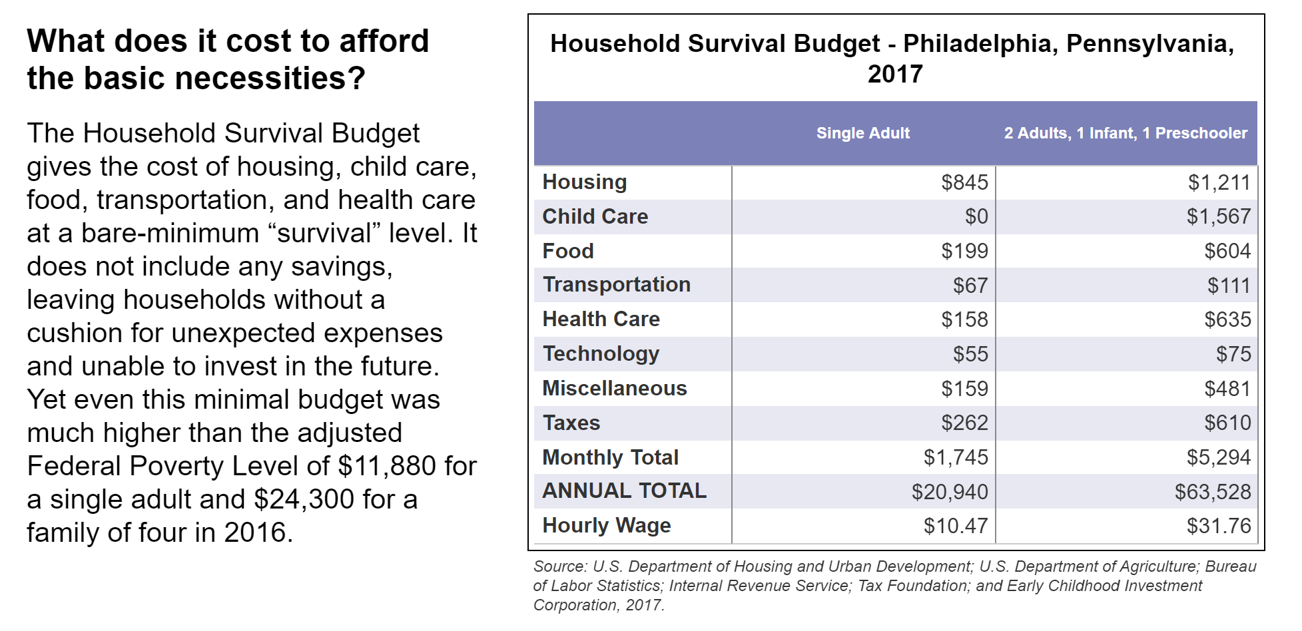
Who is Food Insecure? Meet ALICE: Asset Limited, Income Constrained, Employed
These families live above the poverty line but struggle with household expenses like food.
In 2017, 27% of Philadelphia households (163,658 out of 606,142) were ALICE (in addition to 28% living in poverty)
https://www.unitedforalice.org/pennsylvania
Notes:
Supplemental Information
ALICE, an acronym for Asset Limited, Income Constrained, Employed, is a new way of defining and understanding the struggles of households that earn above the Federal Poverty Level, but not enough to afford a bare-bones household budget.
For far too many families, the cost of living outpaces what they earn. These households struggle to manage even their most basic needs - housing, food, transportation, child care, health care, and necessary technology.
When funds run short, cash-strapped households are forced to make impossible choices, such as deciding between quality child care or paying the rent, filling a prescription or fixing the car. These short-term decisions have long-term consequences not only for ALICE families, but for all of us.
ALICE is your child care worker, the cashier at your supermarket, the gas attendant, the salesperson at your big box store, your waitress, a home health aide, an office clerk. ALICE cannot always pay the bills, has little or nothing in savings, and is forced to make tough choices such as deciding between quality child care or paying the rent. One unexpected car repair or medical bill can push these financially strapped families over the edge.
In 2017 28% at poverty level, 27% ALICE (163,658 households out of total of 606,142 households)
The ALICE Threshold is a realistic standard developed from the Household Survival Budget, a measure that estimates the minimal cost of the six basic household necessities — housing, child care, food, transportation, health care, and a basic smartphone plan. Based on calculations from the American Community Survey and the ALICE Threshold, 1,856,785 households in Pennsylvania — 37 percent —are either in poverty or are ALICE households
​

Slide 32
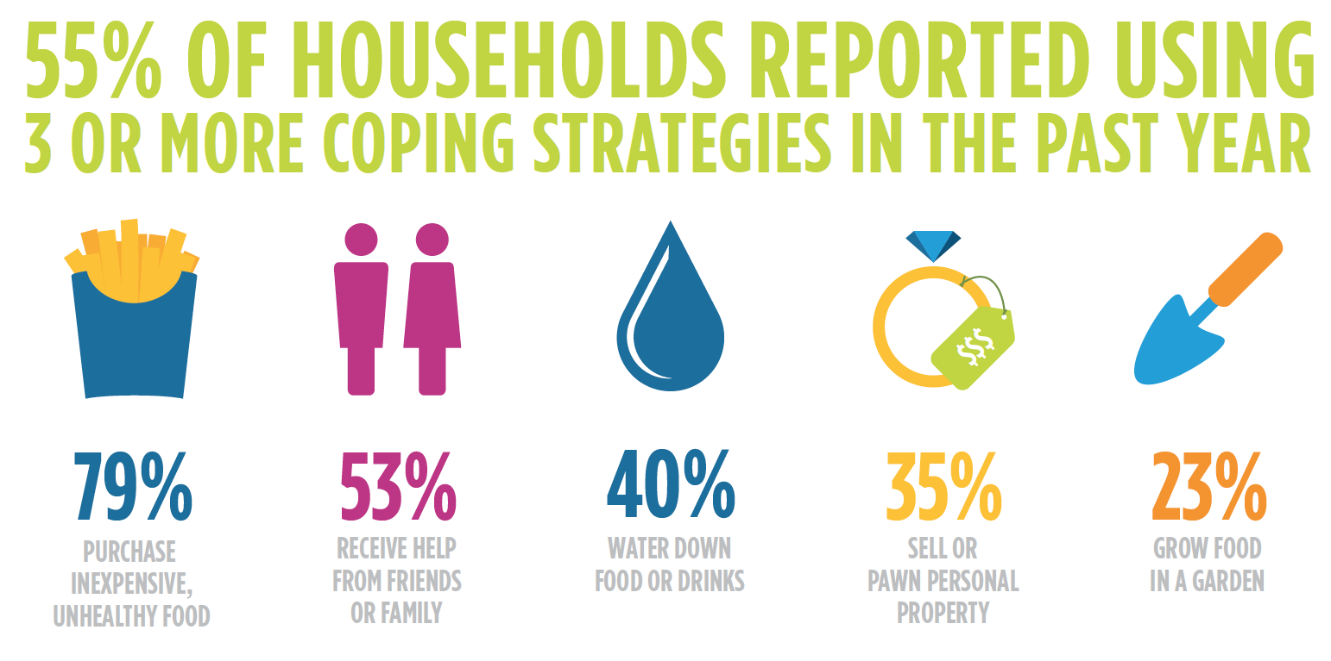
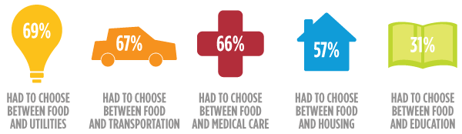
Coping with Food Insecurity
These households face tough choices and trade-offs.
Source: Hunger in America 2014, Feeding America
Notes:
Feeding America. (2014, August). Hunger in America 2014. Westat and the Urban Institute. Retrieved from http://help.feedingamerica.org/HungerInAmerica/hunger-in-america-2014-fullreport.pdf
Supplemental Information
https://nopren.org/wp-content/uploads/2016/12/RxforCalFresh_SDHC.PD_.pdf
“As a result, many low-income individuals and families find themselves making tough decisions between paying for food and other basic needs [25]. As a result, adults who reported food insecurity were four times more likely to report cost-related medication underuse [25]. To complicate matters, food purchasing decisions are made in a context of super markets and corner stores filled with a wide variety of low cost, high calorie foods, allowing households to “fill up for less” when budgets are tight [26,27]. Studies find that low income, food insecure families are especially vulnerable, decreasing fruit and vegetable servings while maintaining consumption of high carbohydrate foods like juices and starches [8,28,29]. These purchases, however, come at a price of short and long term health consequences, often in the form of overweight, obesity and chronic disease [29].”

Slide 33

The Cost of Healthy Eating
In order to eat the USDA-recommended meal plan, families with low income would have to spend 43 to 70 percent of their food budget on fruits and vegetables.
Cassady, D, Jetter, KM, Culp, J. Is price a barrier to eating more fruits and vegetables for low-income families? J Am Diet Assoc. 2007;107(11), 1909-15.
Notes:
Add to the other constraints food insecurity imposes, consider the specific challenge of healthy eating on a tight budget.

Slide 34
Food Insecurity & Health
https://youtu.be/q0VQjtE8vRg
Notes:
[This may look like a blank black screen but in slideshow mode you will be able to click and play the video directly in PowerPoint.]
Given the trade-offs patients are making, it’s not surprising that their health is affected. This video describes the relationship between food insecurity and health.
For more information:
https://hungerandhealth.feedingamerica.org/understand-food-insecurity/hunger-health-101/

Slide 35
Impact of Food Insecurity on Health
Food insecurity is associated with these health issues:
Higher levels of chronic disease, such as diabetes, hypertension, coronary heart disease, hepatitis, stroke, cancer, asthma, arthritis, chronic obstructive pulmonary disease, and chronic kidney disease^{1,2}
Medication non-adherence³
Poor diabetes self-management⁴
Higher probability of mental health issues, like depression⁵
1 Irving SM, Njai R, Siegel P. Food insecurity and self-reported hypertension among Hispanic, black, and white adults in 12 states, behavioral risk factor surveillance system. Prev Chronic Dis. 2014; 11:E161.
2 Seligman, HK, Bindman, A, Vittinghoff, E, et al. Food insecurity is associated with Diabetes Mellitus: Results from the National Health Examination and Nutrition Examination Survey (NHANES) 1999-2002. J Gen Intern Med 2007; 22 (7): 1018–23.
3 Ippolito, M., Lyles, C. Prendergast, K., Seligman, H. Food insecurity and diabetes selfmanagement among food pantry clients. Public Health Nutr 2016; 20(1): 183-189.
4 Seligman, H., Jacobs, E., Lopez, A., Tschann, J., Fernandez, A. Food insecurity and glycemic control among low-income patients with Type 2 diabetes. Diabetes Care 2012; 35 (2): 233–8.
5 Silverman, et al. The relationship between food insecurity and depression, diabetes distress and medication adherence among low-income patients with poorly-controlled diabetes. J Gen Intern Med; 2015; 30 (10): 1476.

Slide 36
Food Insecurity Among Children
1 in 5 children in Philadelphia live in food insecure households. (Source: Map the Meal Gap 2017, Feeding America)
Children experiencing food insecurity have increased rates of:¹
Behavioral issues (e.g., being less attentive, more aggressive and at a higher risk of delays in cognitive and social development)
Low birth weight and high risk of infant mortality
Anemia, asthma and poor oral health
Increased school absences, reduced concentration and poor performance on cognitive tests
Fatigue, headaches, anxiety, and depression.
¹ Gundersen, C. and Ziliak. J. Food insecurity and health outcomes. Health Aff. 2015; 34(11): 1830-1839.
Notes:
Food insecurity has serious negative effects across the lifespan…

Slide 37
Food Insecurity Among Seniors
According to the Philadelphia Corporation for Aging, hunger among Philadelphians aged 60+ rose from 11% to 12.25% between 2015 and 2018.
Food insecurity in seniors is associated with:
Increased risk of depression, asthma, poor self-reported health status, and activity limitations.¹
Greater likelihood of suffering from heart conditions, such as heart attacks and coronary heart disease.²
¹ Gundersen, C. and Ziliak. J. Food insecurity and health outcomes. Health Aff. 2015; 34(11): 1830-1839.
² Feeding America, National Foundation to End Senior Hunger. Spotlight on Senior Health: Adverse Health Outcomes of Food Insecure Older Americans. 2014.

Slide 38
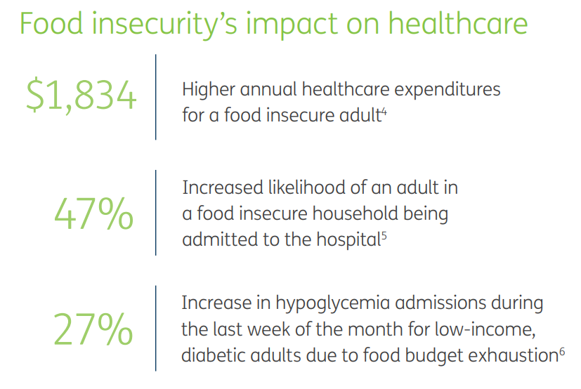
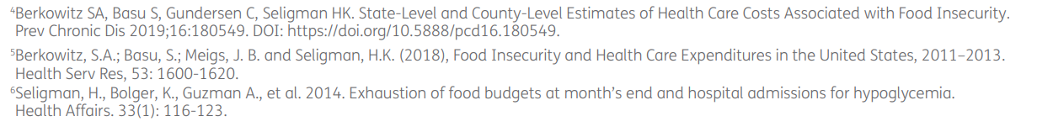
Impact on the Health Care System
According to the Center for American Progress, the annual illness costs linked to hunger and food insecurity in America is $130 billion.
Notes:
https://populationhealth.humana.com/wp-content/uploads/2019/11/Food-Insecurity-Policy-Brief-2019.pdf

Slide 39
Module 3: Identifying & Addressing Food Insecurity in Healthcare Systems

Slide 40
Module 3, Part A: Screening & Intervening

Slide 41
“Screen and Intervene” Process
Screen all patients routinely for food insecurity, using a brief, validated tool
Document the results of the screen
If positive, discuss patients’ preferences and priorities and provide appropriate referrals and/or resources if requested
Follow up with patients to find out if they connected with the resources and their need was ultimately met
Screen all patients routinely for food insecurity using a brief, validated tool
Notes:
This is the basic process for screening and intervening COACH participants are implementing.
COACH is a collaborative of 8 health systems in Greater Philadelphia who are working together to screen for food insecurity in varied clinical sites and responding to needs with referrals to resources and interventions such as pop up markets and summer meal programs.

Slide 42
Collaborative, Team-Based Approach
Given the limits of time and resources in busy clinical settings, a team-based approach to screening and intervening is strongly recommended.
Consider who has the time, skills, and experience to talk to patients about sensitive topics and navigate patients through resource connection.
Though physicians may not be involved in screening directly, they can play an important role in supporting the patient with resources and use the information for treatment planning.

Slide 43
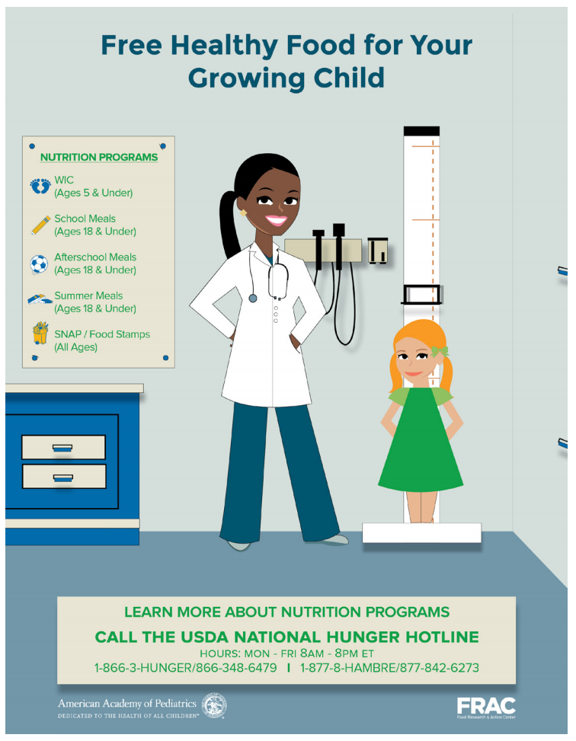
Getting Ready
Get into the mindset: Channel curiosity about your patients’ situations as you get ready for screening.
Prepare the environment: Posters like this in waiting or exam rooms will help set the stage for questions about food and nutrition.
Notes:
Curiosity about your patient as a whole person is a building block to feeling empathy, which encourages a positive dynamic between the patient and you. Empathy contributes to you feeling compassion satisfaction in your work instead of fatigue or burnout.

Slide 44
Being Trauma-Informed
Keep in mind that patients may be dealing with trauma arising from a variety of causes, including food insecurity itself.
As you design your processes, consider how you could do the following for patients:
Convey safety, trustworthiness, and empathy.
Invite their collaboration.
Establish choice and sense of control.
Empower their action.

Slide 45
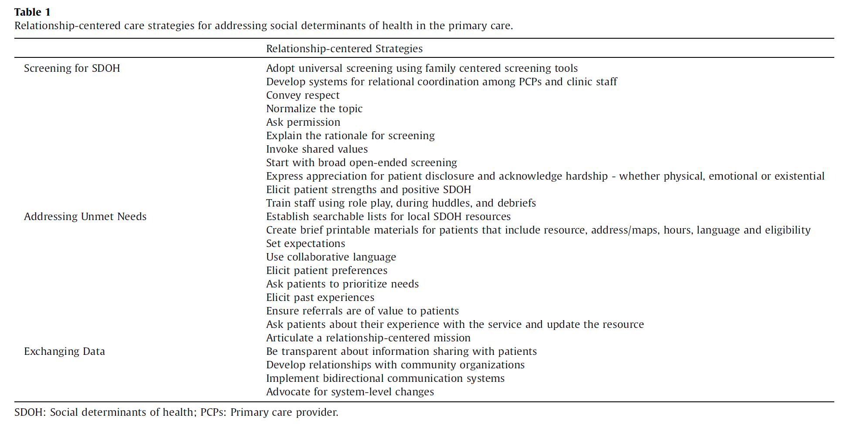
Relationship-Centered Care Principles
Consider applying these principles when screening and intervening.
Schoenthaler A, Hassan I, Fiscella K. The time is now: Fostering relationship-centered discussions about patients' social determinants of health. Patient Educ Couns. 2019 Apr;102(4):810-814.
Notes:
A few key items corroborated by other researchers and experts to highlight include:
Avoid targeted screening; you can’t tell by looking!¹
Since issues may affect a broader swath of the population than anticipated (you can’t always tell by looking), universal screening, rather than targeting screening to patients with specific demographic characteristics, is recommended.
Provide context for your patients to understand why the questions are being asked
Inquire about needs with sensitivity and support.²
Patients may not be forthcoming about their needs, if they fear that they will be judged or reported to Child Protective Services. If screening is conducted verbally, it is necessary to convey as much sensitivity and support as possible.
Adopt a patient-/family-centered, strength-based approach to engaging patients about their needs.¹
To ensure that screening efforts are effective, it is important to adopt a patient- and family-centered, strength-based approach to engaging patients about their needs. This involves eliciting patients’ preferences and desire for assistance, resources they are currently using, what additional resources they think could be of help, and what barriers they are facing.
Ensure actionability and capacity to refer and link to appropriate resources in response to need.¹
Some of these will be elaborated on further in the role-based guidance module.
¹ Garg A, Boynton-Jarrett R, Dworkin PH. Avoiding the unintended consequences of screening for social determinants of health. JAMA. 2016; 316(8):813-4.
² Gottlieb L, Sandel M, Adler NE. Collecting and applying data on social determinants of health in health care settings. JAMA Internal Medicine. 2013; 173 (11): 1017-1020.

Slide 46
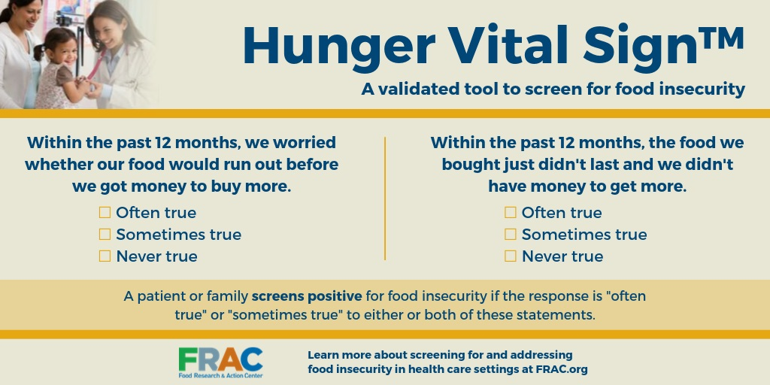
Food Insecurity Screening Tool
Hunger Vital Sign
https://childrenshealthwatch.org/public-policy/hunger-vital-sign/
Notes:
Supplemental Information
What is the Hunger Vital Sign™?
In 2010, Drs. Erin Hager and Anna Quigg and the Children’s HealthWatch team developed the Hunger Vital Sign™, a validated 2-question food insecurity screening tool based on the U.S. Household Food Security Survey Module to identify households at risk of food insecurity.
The Hunger Vital Sign™ identifies households as being at risk for food insecurity if they answer that either or both of the following two statements is ‘often true’ or ‘sometimes true’ (vs. ‘never true’):
“ Within the past 12 months we worried whether our food would run out before we got money to buy more.”
“ Within the past 12 months the food we bought just didn’t last and we didn’t have money to get more.”
The peer-reviewed journal article on the Hunger Vital Sign™ has been cited in hundreds of publications since its release and the screening tool has been used widely in medical and community-based settings around the country. In 2015 the Hunger Vital Sign™ was validated for use among youth and adolescents, and in 2017 the Hunger Vital Sign™ was validated for use among adults as well.
In October 2015, the American Academy of Pediatrics released a policy statement, recommending that pediatricians screen all children for food insecurity. In May 2017, the Centers for Medicare & Medicaid Services incorporated the Hunger Vital Sign™ in the Accountable Health Communities Screening Tool.
There is no fee or license required to use the Hunger Vital Sign™. We only ask that parties properly cite the tool as follows:
Hager, E. R., Quigg, A. M., Black, M. M., Coleman, S. M., Heeren, T., Rose-Jacobs, R., Cook, J. T., Ettinger de Cuba, S. E., Casey, P. H., Chilton, M., Cutts, D. B., Meyers A. F., Frank, D. A. (2010). Development and Validity of a 2-Item Screen to Identify Families at Risk for Food Insecurity. Pediatrics, 126(1), 26-32. doi:10.1542/peds.2009-3146.
**[Need to address whether food insecurity screening is happening in the context of screening for other social needs]**
[Also not sure how to best address Bottino’s finding: asking patients if they would like food assistance referrals identified more families than standard FI screening alone—asking for preferences and if they would like help, selected more referrals. Bottino CJ, Rhodes ET, Kreatsoulas C, Cox JE, Fleegler EW. Food insecurity screening in pediatric primary care: Can offering referrals help identify families in need? Acad Pediatr. 2017;17(5):497-503. PMID: 28302365.]

Slide 47
Acceptability to Patients & Clinicians
Screening for food insecurity in a variety of clinical settings has been found to be well-received by patients and clinicians alike.^{1,2}
Growing evidence suggests that screening methods that preserve anonymity (e.g., written or tablet-based screening, screening in the emergency department) elicits higher rates of disclosure.²
When done right, asking about social needs helps patients feel cared for and can strengthen patient-provider relationships.
¹ Torres J, De Marchis E, Fichtenberg C, Gottlieb L. Identifying Food Insecurity in Health Care Settings: A Review of the Evidence. 2017. San Francisco, CA: Social Interventions Research & Evaluation Network. Available online.
² Cullen D, Woodford A, Fein J. Food for thought: A randomized trial of food insecurity screening in the emergency department. Acad Pediatr. 2019 Aug;19(6):646-651.

Slide 48
Screening with Sensitivity
If you are screening verbally, it will be critical to approach screening with sensitivity and empathy.
Food insecurity is a sensitive subject. Patients may be embarrassed, ashamed, uncomfortable, or even afraid to admit that they struggle to meet the food needs of their families.
Notes:
Supplemental Information
https://frac.org/wp-content/uploads/frac-aap-toolkit.pdf
• Food insecurity is a sensitive subject. Parents and caregivers may be embarrassed, ashamed, uncomfortable, or even afraid to admit that they struggle to meet the food needs of their families. • Parents and caregivers also may be reluctant to talk about any of this in front of their children. Parents often try to protect their children from food insecurity by, for example, sacrificing their own food and nutrition needs so that their children can eat. Research shows, however, that children, particularly older children, are more aware of their families’ food insecurity than their parents realize.
• Not only may parents try to hide food insecurity from their children, but they also may try to hide it from their friends, family, coworkers, and health care providers. Hunger may be lurking behind a well-groomed and well-dressed appearance. Families also may have possessions that give the appearance of financial stability (e.g., vehicles, cell phones), but they actually could be struggling due to recent unemployment or unexpected expenses, or struggling to pay for other basic needs. Furthermore, food insecurity can coexist with obesity, and the practice team should not be surprised that someone may be simultaneously struggling with weight issues and food insecurity. In short, hunger is often invisible.
• Families also may experience shame or embarrassment when medical providers suggest that the family apply for food assistance programs or visit local emergency food sites. Stigma surrounding assistance programs and emergency food has long been identified as a barrier to participation. Negative perceptions or experiences can lead to embarrassment or shame in inquiring about assistance, going to a food pantry, or participating in programs like the Supplemental Nutrition Assistance Program (SNAP) or the Special Supplemental Nutrition Program for Women, Infants, and Children (WIC).
• Many practices also face additional challenges in addressing food insecurity in a sensitive manner with patients from different cultures or whose preferred language is not English.
Normalize by connecting to these situations:
Health professionals discuss availability of food in the home when they prescribe medication in order to ensure that the patient takes the medication appropriately. Health professionals may also discuss food when they notice that a patient is underweight, or in the context of chronic disease self-management, such as regulating diets for patients with diabetes.
It’s All About Trust
Parents’ recommendations for pediatricians: • Build trust. • Choose the right moment for parents. • Not in front of the children. • Let parents choose to learn about helpful resources at their own initiation. • Signal confidentiality and be transparent about what triggers reporting to child welfare. • Do not ask just for the sake of asking. • Make clear that screening is standard protocol. • Consider “letters of support” and other ways to be parents’ allies.

Slide 49
Responding to a Positive Screen
[Please include institution-specific workflows here]

Slide 50
Possible Additional Questions
To help direct your support of patients who have food needs, you might consider asking:
If they would like assistance
If they are already receiving services or participating in programs
About potential barriers to accessing resources
About the kinds of resources they are most interested in.
Notes:
For example, some examples of programs that you may hear or probe about include SNAP, WIC, nutrition classes, Philly Food Bucks, etc.
Some potential barriers may include: transportation to pick up food, a disability that makes it hard to get around, a difficult work schedule, a lack of childcare, etc.

Slide 51
Addressing Food Needs
Providing patients resource lists alone is not sufficient to facilitate resource connection and ultimately meet their needs.
Local research¹ has demonstrated the complexity of patients’ situations that prevented resource connection:
Food insecurity was just one of several other significant social needs patients were balancing.
Patients encountered significant system barriers.
Swavely D, Whyte V, Steiner JF, Freeman SL. Complexities of addressing food insecurity in an urban population. Popul Health Manag. 2019;22(4):300-307.

Slide 52
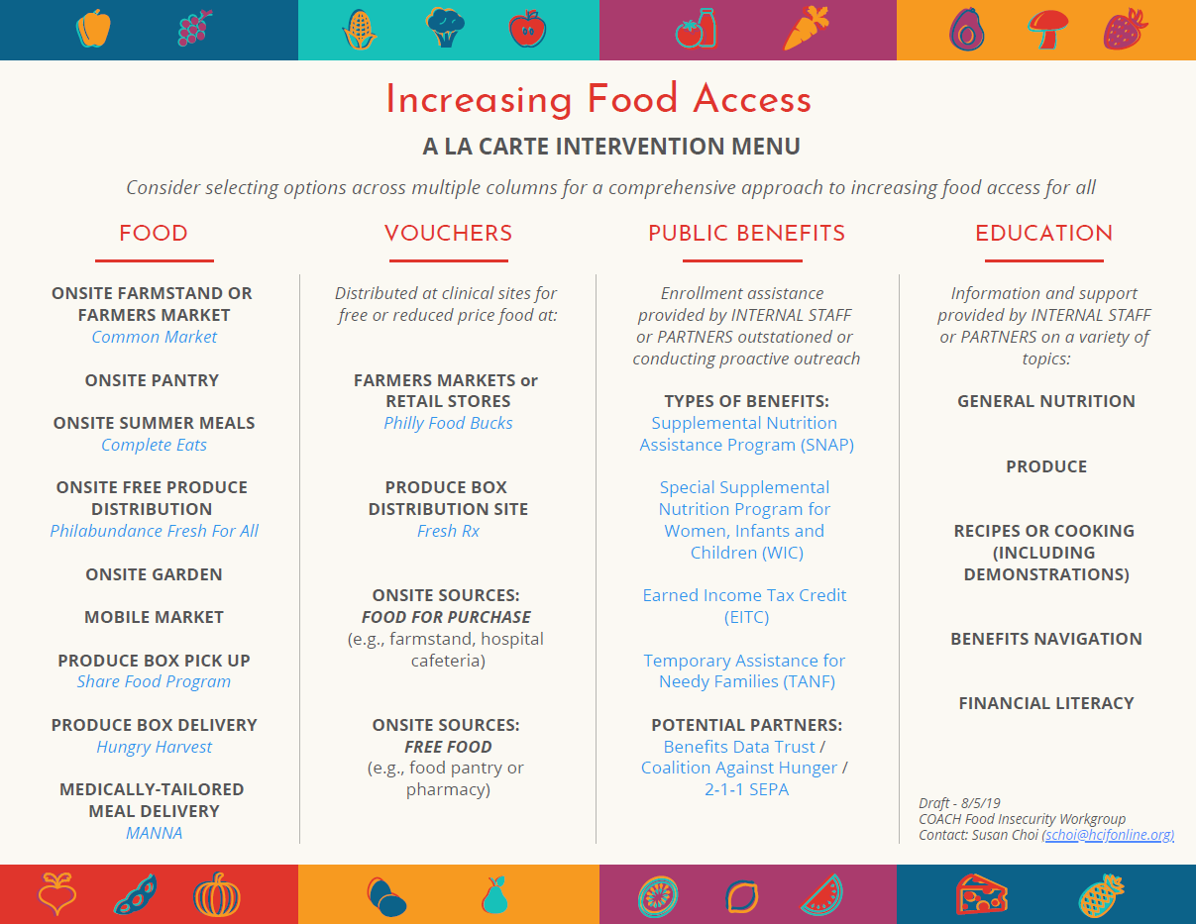
Types of Resources & Interventions
Notes:
So it seems that a more comprehensive, layered approach that offers patients multiple types of resources (immediate vs. longer term, food vs. other resources) presents the possibility of meeting patients where they are and offers them choice with regards to types of resources.
This “menu” was developed through COACH in 2019 to present possible interventions COACH members could consider adopting.

Slide 53
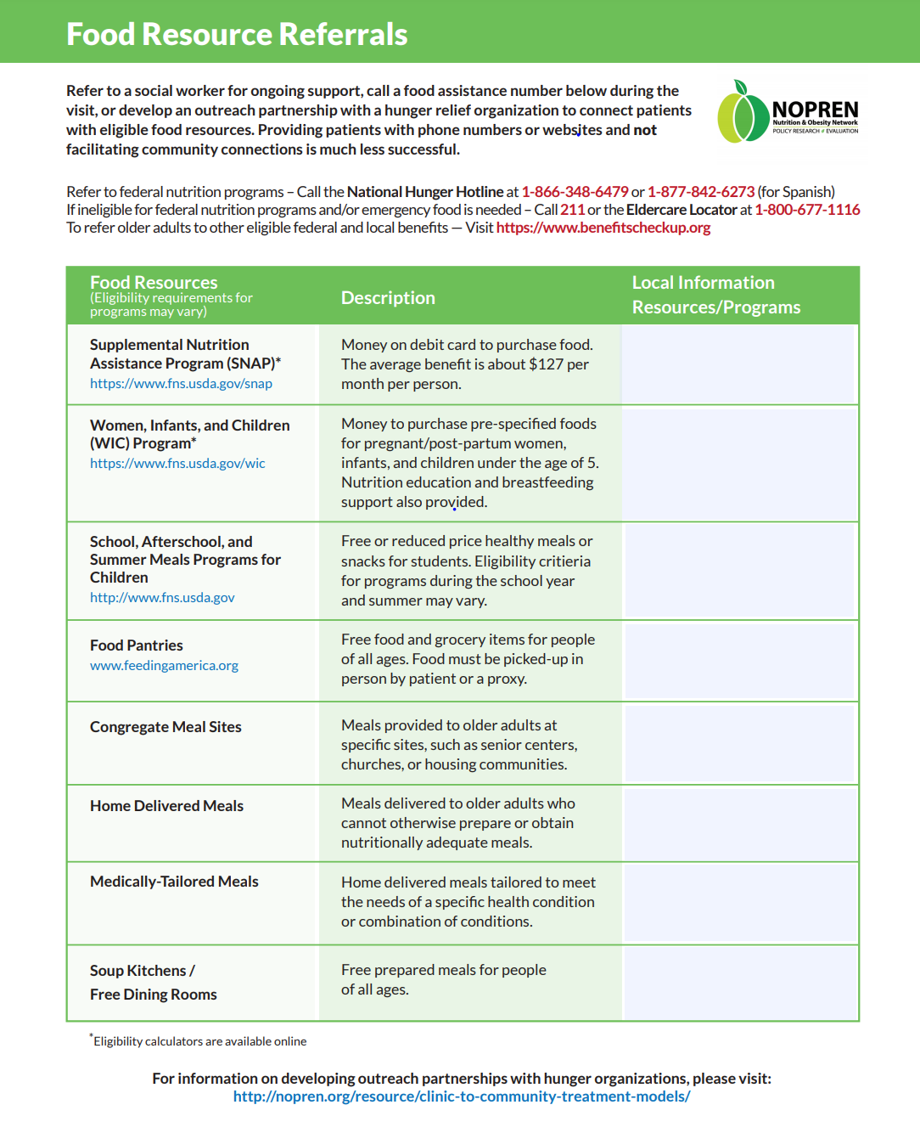
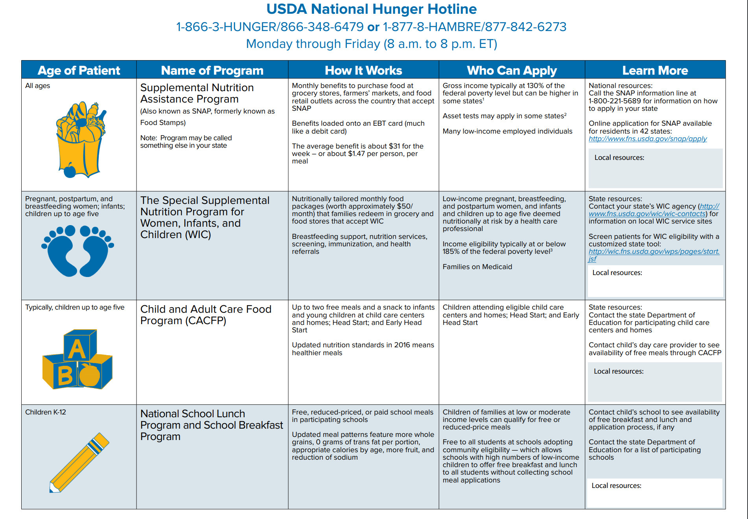
Examples of Program Lists
https://frac.org/wp-content/uploads/frac-aap-toolkit-chart-fed-program-referral.pdf
https://nopren.org/wp-content/uploads/2017/10/Clinical-Linkages-Adults-FI-Screening-Algorithm-10.9.17.pdf
Notes:
**This is not to encourage lists necessarily but the thought is to use this slide to elaborate on a few of the key USDA programs**
Supplemental Information
Senior-focused USDA programs:
Commodity Supplemental Food Program (CSFP) What the Program Does: The CSFP supplements the diets of low-income older Americans who are at least 60 years old with a monthly food package. Food packages include a variety of foods, such as shelf-stable milk, juice, farina, oats, ready-to-eat cereal, rice, pasta, peanut butter, dry beans, canned meat, poultry, or fish, and canned fruits and vegetables. Whom the Program Serves: CSFP operates in 47 States, the District of Columbia, and 2 Indian Tribal Organizations (ITOs). Older persons at least 60 years old can apply. States establish income limits at or below 130 percent of the Federal Poverty Income Guidelines. To Learn More: http://www.fns.usda.gov/csfp/commodity -supplemental-food-program-csfp
Elderly Nutrition Program What the Program Does: Authorized by the Older Americans Act (OAA), the Elderly Nutrition Program provides grants to states and tribal organizations to provide congregate and home-delivered meals (commonly referred to as “Meals on Wheels”) to older adults. Meals provided through the Elderly Nutrition Program must adhere to the Dietary Guidelines for Americans and provide at least onethird of older adults’ dietary reference intakes. Whom the Program Serves: The Elderly Nutrition Program serves adults aged 60 and older. There is no means -based test to participate in the Elderly Nutrition Programs, but services may be targeted to vulnerable populations, including older adults with low incomes, living alone or socially isolated, living in rural areas, or at nutritional risk. To Learn More: http://www.aoa.acl.gov/AoA_Programs/ HPW/Nutrition_Services/index.aspx
Senior Farmers’ Market Nutrition Program (SFMNP) What the Program Does: The SFMNP awards grants to states, U.S. Territories and federally recognized Indian tribal governments to provide low-income older adults with coupons that they can exchange for eligible foods at farmers’ markets, roadside stands, and community supported agriculture (CSA) programs. Whom the Program Serves: Low-income older adults, generally defined as individuals who are at least 60 years old and who have household incomes of not more than 185 percent of the Federal Poverty Income Guidelines. To Learn More: http://www.fns.usda.gov/sites/default/ files/sfmnp/SFMNPFactSheet.pdf

Slide 54
Institution-Specific Plans
[Fill in details of your screen and intervene project(s):
Screening sites
Roles and responsibilities for whole team (who is screening, who is intervening with positive screens)
Screening modality
Types of resources provided
Referral partners/institutions
Workflow details (see questions in notes)]
Notes:
Potential Questions
At what types of visits will patients be screened? How often?
How will patients access the screening tool to complete it? (Ex: EMR portal, paper version in office, laminated wipe‐away, tablet)
If paper, who will ensure that copies of the screening tool are available for patients to complete each day?
When in the visit will the patient receive the screening tool?
Who will give the patient the screening tool?
Who will score the screening tool?
When will the provider review the screening results with the patient and work with them to make a plan for next steps?
Who will be responsible for facilitating referrals and other interventions?
Where will referrals/resources be documented?
What happens with the screening tool after it has been discussed with the parent? (Ex: results recorded in EMR, scanned into chart, shredded, wiped away)
Who will give the patient educational materials? When will these be presented?
Where will you keep your supply of educational materials?
Who will make sure that materials (including screening tools and educational materials) are restocked and readily available?
Who will facilitate following up with patients to determine the outcomes of the referral?
Where will follow‐up notes be recorded?
Potential tips to consider:
• If you have an on-site food pantry or shelf, make sure it is located where patients can access food in private. Also consider how patients will be able to get the food home (e.g., it might be easier for people to use tote bags instead of boxes).

Slide 55
Institution-Specific Results
[For those with screening and intervening efforts that have been up and running for some time, share the results of the efforts here]

Slide 56
Module 3, Part B: National and Local Programs

Slide 57
Spotlight on SNAP: Major Takeaways
The following slides provide an overview of the Supplemental Nutrition Assistance Program (SNAP). The key points to keep in mind:
SNAP is a critical tool for combating food insecurity.
Getting and keeping SNAP benefits can be difficult due to eligibility and application requirements.
The amount of SNAP benefit is often not enough for most households, but research shows that it provides a crucial stepping stone to better health.

Slide 58
Spotlight on SNAP: Eligibility
Supplemental Nutrition Assistance Program (SNAP) is an important tool in fighting food insecurity.
SNAP provides support for low-wage working families, low-income seniors and people with disabilities.
General eligibility rules for households in fiscal year 2019:
Gross monthly income at or below 130 percent of poverty line, or $2,252 a month (about $27,020/year) for a three-person family.
Net monthly income less than or equal to poverty line ($1,732 a month or about $20,780/year for a three-person family).
Assets below $2,250 for households without elderly or disabled members.
Some documented immigrants and certain non-citizens (refugees and asylees from certain countries) are eligible.
Notes:
More than two-thirds of SNAP participants are in families with children; a third are in households with seniors or people with disabilities.
As you can see, to be eligible for SNAP, households have to have very few resources.

Slide 59
Spotlight on SNAP: Logistics
Application process involves eligibility interview and documentation of identity, residency, immigration status, household composition, income and resources, deductible expenses.
Those eligible receive an electronic benefit transfer (EBT) card that is loaded with benefits once a month.
Households must reapply for SNAP periodically, typically every six to 12 months for most families and every 12 to 24 months for seniors and people with disabilities.
Notes:
Household members may use it to purchase food at one of the 263,000 retailers authorized to participate in the program. More than 80 percent of benefits are redeemed at supermarkets or superstores. Farmers’ markets often accept SNAP benefits.
SNAP benefits can be used for grains, fruits, vegetables, meat, fish, dairy, seeds, and most other food items found in grocery stores.
SNAP cannot be used to purchase alcoholic beverages, cigarettes, vitamin supplements, non-food grocery items such as household supplies, or hot foods.

Slide 60
Spotlight on SNAP: Size of Benefit
Benefit formula assumes families will spend 30 percent of their net income for food.
SNAP makes up the difference between that 30 percent contribution and the cost of the Thrifty Food Plan (TFP), a diet plan developed by the U.S. Agriculture Department (USDA).
Recent analyses show that the Thrifty Food Plan does not allow for sufficient resources for a healthy diet.^{1,2}
Therefore SNAP benefits may not be adequate to prevent food insecurity, let alone support nutritious eating.
1 Breen AB, Cahill R, Ettinger de Cuba S, Cook J, Chilton M. The real cost of a healthy diet. 2011. Boston, MA: Children’s HealthWatch.
2 Sheldon M, Gans KM, Tai R, George T, Lawson E, Pearlman DN. Availability, affordability, and accessibility of a healthful diet in a low-income community, Central Falls, Rhode Island, 2007-2008. Prev Chronic Dis. 2010; 7(2): A43.
Notes:
Supplemental Information
https://frac.org/wp-content/uploads/thrifty_food_plan_2012.pdf
“Everything must be perfectly aligned for the TFP to work as intended – a person needs: access to a store (or multiple stores to bargain hunt) with a wide variety of foods at very competitive prices; transportation to the store; adequate resources to use at the store throughout the month; adequate and reliable storage space and cooking equipment; sufficient time for food preparation; less waste and spoilage than is commonly accepted as the norm; and so on.”

Slide 61
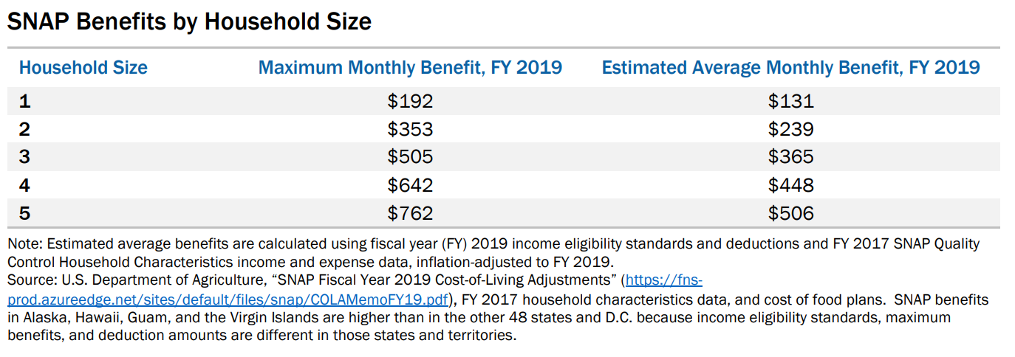
Spotlight on SNAP: Size of Benefit
https://www.cbpp.org/sites/default/files/atoms/files/policybasics-foodstamps.pdf
Notes:
Supplemental Information
“A family with no net income receives the maximum benefit amount, which equals the cost of the Thrifty Food Plan for a household of its size (see table). For example, a family of three with $600 in net monthly income receives the maximum benefit ($505) minus 30 percent of its net income (30 percent of $600 is $180), or $324.”

Slide 62
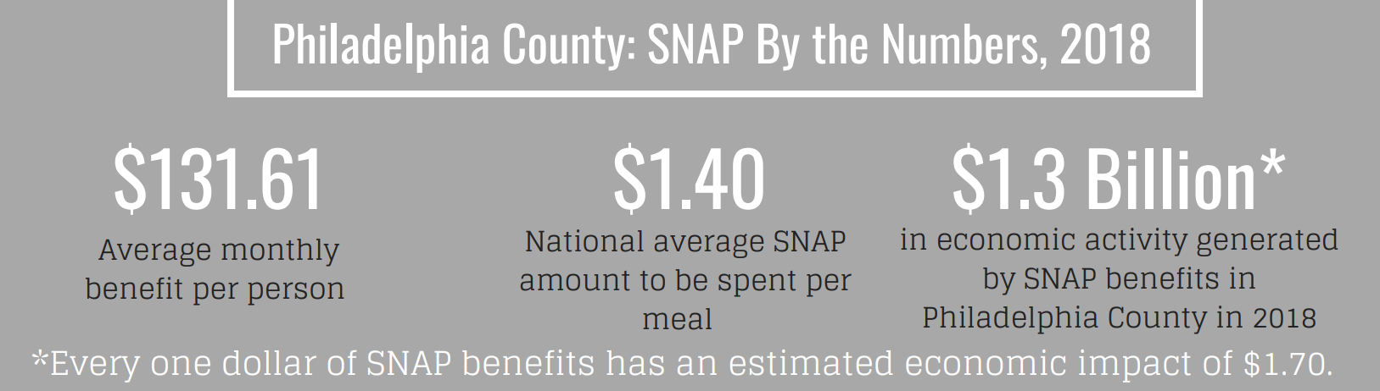
Spotlight on SNAP: Philadelphia Facts
According to data from December 2018, 467,647 Philadelphia residents received SNAP benefits.
Estimated SNAP gap (difference between number who are likely SNAP eligible and the number actually receiving SNAP): 140,000 (many of these are seniors)
http://www.hungercoalition.org/sites/default/files/uploads/Walk2018/PhiladelphiaCounty.pdf

Slide 63
Spotlight on SNAP: Impact on Health
Though the size of the SNAP benefit may not be large enough to prevent food insecurity, recent research has found positive impacts of SNAP benefits.
SNAP has been associated with improved adherence to diabetes treatment for older adults,¹ reduced likelihood of hospitalization among older adults,² and lower annual health care expenditures.³
Loss of SNAP benefits has been associated with greater odds of food insecurity and fair or poor caregiver and child health.⁴
1 Pooler JA, Srinivasan M. Association between Supplemental Nutrition Assistance Program participation and cost-related medication nonadherence among older adults with diabetes. JAMA Intern Med. 2019 Jan 1;179(1):63-70.
2 Berkowitz SA, Seligman HK, Rigdon J, Meigs JB, Basu S. Supplemental nutrition assistance program (SNAP) participation and health care expenditures among low-income adults. JAMA Intern Med. 2017;177(11):1642–1649.
3 Samuel LJ, Szanton SL, Cahill R, et al. Does the Supplemental Nutrition Assistance Program affect hospital utilization among older adults? The case of Maryland. Popul Health Manag. 2017;21(2):88-95.
4 Ettinger de Cuba S, Chilton M, Bovell-Ammon A, et al. Loss of SNAP is associated with food insecurity and poor health in working families with young children. Health Aff (Millwood). 2019;38(5):765-773.

Slide 64






Local Food Access Organizations
The following slides provide an overview of important food access partners in the Philadelphia area.
See descriptions of their programs and direct contact information for each organization.
Notes:
United Way?

Slide 65
Benefits Data Trust
BenePhilly
BenePhilly is a free program that helps low-income Philadelphians enroll in critical benefits and services over the phone.
BenePhilly’s Toll Free #: 1-833-373-5868
Interested in ways your organization can get involved? Email Benephilly@bdtrust.org for more information.

Slide 66
The Food Trust www.thefoodtrust.org
Select Programming Areas:
Healthy Food Incentives/Produce Prescription Programs: Healthy food incentives, including Food Bucks and Food Bucks Rx, help reach a common goal of increasing access to affordable fresh produce. Food Bucks are earned via SNAP purchases at participating retailers (farmers markets, select corner stores and supermarkets) or through community distribution; they are redeemable for fresh fruits and vegetables. Food Bucks Rx are distributed to patients in healthcare settings.
Farmers Markets: TFT operates 20+ farmers markets in the Philadelphia area, many of which are located in neighborhoods with limited to no consistent access to affordable, fresh food and some co-located near health care institutions. These markets accept SNAP, WIC, FMNP/SFMNP and Food Bucks, and support our local farmers and economy.
Financing and TA for Healthy Food Retail: The Pennsylvania Fresh Food Financing Initiative (PA FFFI) is a statewide program that provides one-time grants, loans and/or technical assistance to increase access to healthy, affordable food in lower-income communities underserved by fresh food retail. In addition, through healthy corner store initiatives, TFT supports small food retailers to source, stock and sell healthy affordable foods.
Nutrition Education + Health Screenings: Nutrition lessons, cooking workshops and store tours are key components of TFT’s SNAP-Ed funded services for adults and youth at food retail sites, schools, and other community settings. In addition, The Food works with hospital staff to support nutrition education for patients and also enable health screenings in settings such as healthy corner stores. Screenings and lessons are often accompanied by healthy food incentives (e.g. Heart Bucks or Food Bucks) for participants.
Future opportunities for potential partnerships:
Health screenings alongside nutrition lessons to create more “community health hubs”
Funding support, e.g. farmers market sponsorships, match funding for federal grants, and direct program funding
Research and advocacy on food policy initiatives
All other ideas around healthy food access and affordability!
Contact: Julia Koprak, Senior Associate, (215) 383-5358, jkoprak@thefoodtrust.org

Slide 67
Greater Phila. Coalition Against Hunger
www.hungercoalition.org
Key programs
1. Immediate Relief: We connect people in need with, and provide hands-on support to, food pantries and soup kitchens; and we provide close to 200,000 lbs of food for pantries each year!
2. Short-Term Relief: We help thousands of people apply for SNAP (food stamp) benefits through our SNAP Hotline, case management, and community outreach efforts. We participate in over 100 community events each year to reach people where they are, helping them connect to food and food resources, including summer meals.
3. Long-Term Relief: At the local state and federal levels we call for and support responsible policies that address the realities families face putting food on their tables.
Notes:
-Key organizational contact: Tanya Sen, Community Nutrition Program Manager, tsen@hungercoalition.org, 215-430-0555, x101
-Call the SNAP Hotline at 215-430-0556 for assistance applying for SNAP and addressing other SNAP or food concerns.
-To sign-up for anti-hunger advocacy alerts go to: https://hungercoalition.salsalabs.org/advocacyalerts/index.html
-To arrange for someone to come out and do a staff or client meeting presentation on our work, hunger in the Philadelphia region and food resources available or to do a hunger simulation education exercise, contact Katie Milholin at kmilholin@hungercoalition.org.

Slide 68
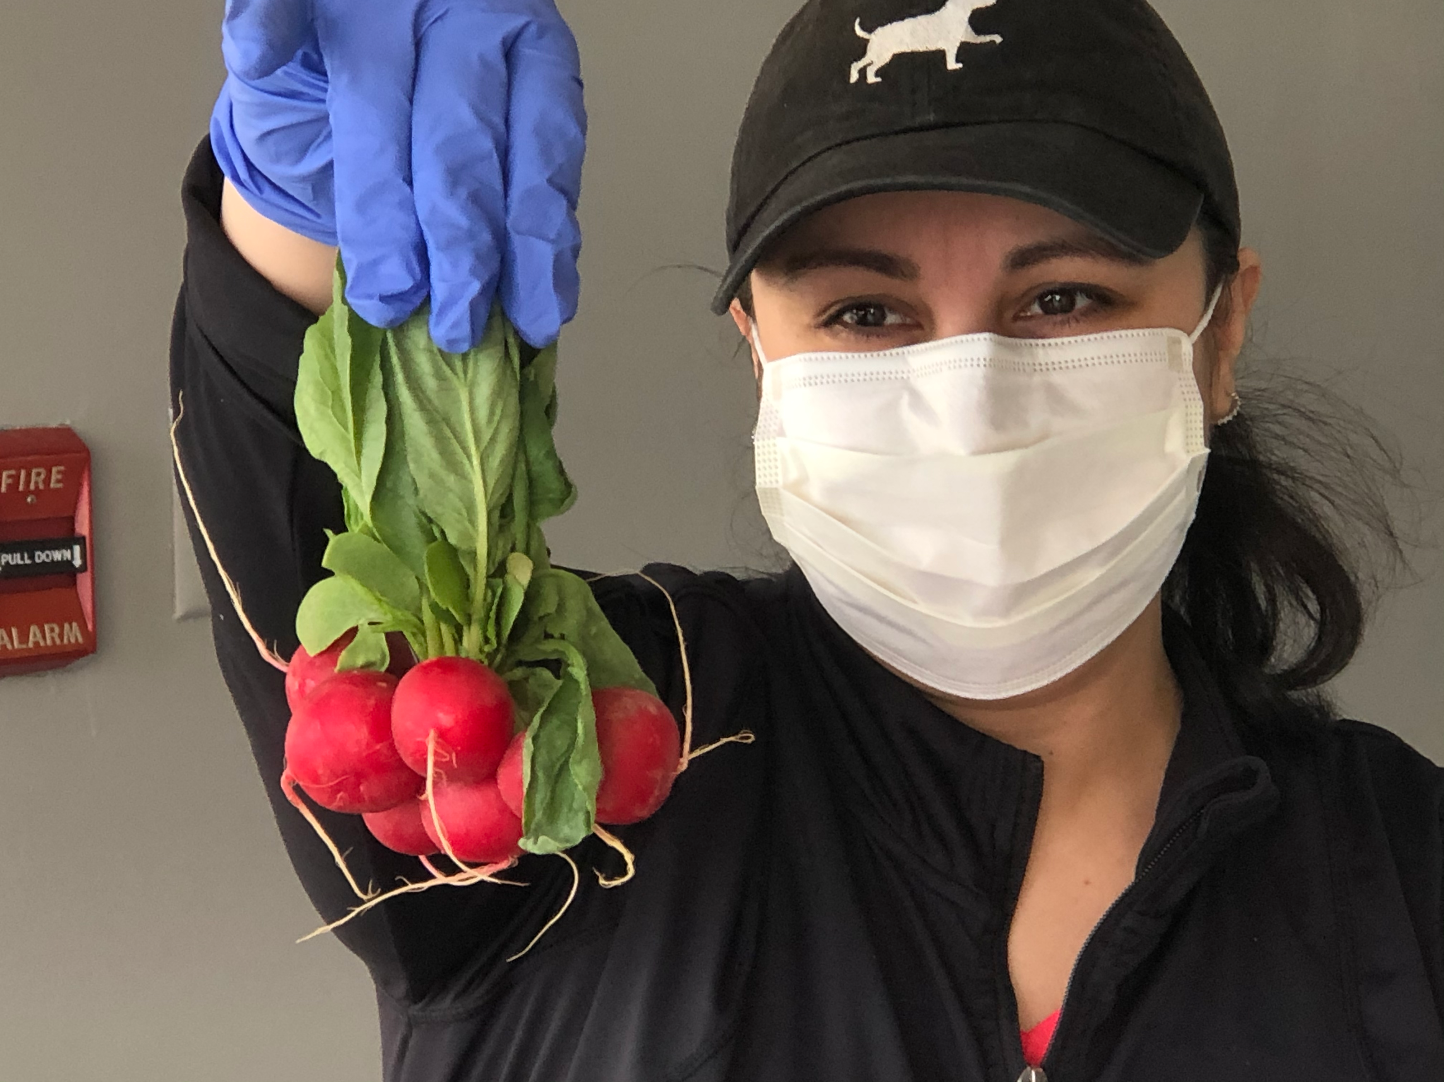
Greener Partners
Building health through farming, food & education
http://www.greenerpartners.org/
Key Programs:
Food Access: Deaver Wellness Farm @ Lankenau Medical Center and Rooftop Farm at MLH King of Prussia; free weekly produce & food education at schools and community partners; Covid-19 emergency weekly produce distributions in West Philadelphia, Chester & Norristown
Food Education: Farm Explorer mobile farm field trip travels to +60 schools and institutions for hands-on seed to plate learning about growing and cooking; Farm Elective for Medical Residents at Lankenau
Food Sovereignty: Supporting school & community gardens to build food self-reliance with free expertise and gardening materials
Helen Nadel, Ed.M., Education & Partnerships Director, (c) 415-713-4492. helen.nadel@greenerpartners.org
Future Opportunities: Growing food on-site for a health care partner; fruit & vegetable distributions combined with food education (recipes, storage & cooking tips, plus food demos and samples when safe to do so); Farm Explorer visits

Slide 69
Philabundance
www.philabundance.org
Key Programs:
Relieve Hunger Now: network of 350+ members serving clients directly in the community
Ending Hunger For Good: collaborative partnerships which pair healthy food and other critical services to work toward long term solutions to food insecurity.
Healthcare Partners interested in distributing food or connecting patients to food resources should reach out to:
Emily Glick – Manager, Agency Relations
eglick@philabundance.org
215-339-0900 x. 2164

Slide 70
Share Food Program
Share Food Program
Commodity Food Supplemental Program (CSFP) is a hunger relief program designed for senior citizens.
Emergency Food Relief program and The Emergency Food Assistance Program combined alleviate hunger and food insecurity within the city of Philadelphia.
We are always open to partnerships with other agencies. If there is a need for food we are willing to provide.
Danny Griffith, Operations and Public Policy Manager, dgriffith@sharefoodprogram.org, 215-223-2220 x104

Slide 71

Impact of Interventions on Health
Recent compilation of research studies providing evidence of the positive impact of particular types of interventions on health is available here:
https://foodismedicinema.org/fim-research-1

Slide 72
Module 4: Role-Based Guidance for Healthcare Systems

Slide 73
If you’re at the front desk
People may approach you with questions about the screening tool.
Be prepared to share the purpose of the screening:
“We are asking all of our patients these questions.”
“We want to be sure that all of our patients are connecting to resources for which they might be eligible.”

Slide 74
If you’re conducting the screening
If screening is happening verbally, reinforce what staff at the front desk are saying:
All patients are being screened (no one is being singled out or targeted).
The reasons and context for screening (e.g., seeing many people with food needs, being sure that people are connected to resources, ensuring access to food is critical to health).
Consider asking the questions while children are not in the room or distracted.

Slide 75
If you’re conducting the screening
If screening is happening verbally, here are possible scripts for introducing the questions:
“Our goal is to provide the best possible care for your child and family. That’s why we ask all patients about their access to food. We would like to make sure that you know all the resources that are available to you for your problems. Many of these resources are free of charge.”
“I’m seeing so many patients that have a hard time affording food, so I’m asking all my patients some questions about this. Please let me know if these statements are true for you and your family…”

Slide 76
If you’re connecting patients to resources
After a positive screen, affirm their experience:
“That must be very difficult. I'm glad you shared this with me because the kinds of foods you eat are really important for your health. I’d like to connect you to a local organization that can help you access available food assistance programs, such as food pantries near your home and the Supplemental Nutrition Assistance Program, which is often called SNAP. I can help you connect to them now, if you’re interested.”
To help target resources and interventions, ask:
“Can you tell me what resources you are already using? What types of programs would be helpful to you? What barriers to getting to these resources can I help you with?”
Notes:
You may consider acknowledging that sometimes people are embarrassed to admit that they are struggling or that they need help. Commend the parent or caregiver for his/her honesty about the issue and reassure him/her that they are not a bad parent for needing assistance.
Guidance from:
https://www.aappublications.org/news/2016/02/11/FoodInsecurity021116

Slide 77
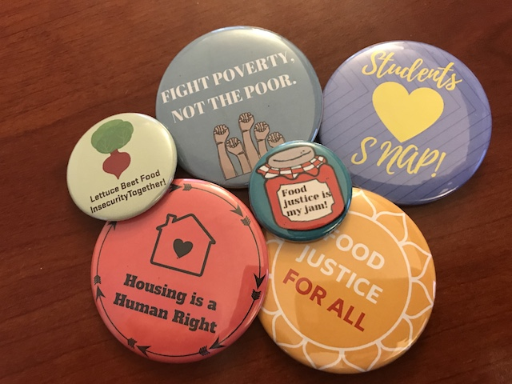
If you’re connecting patients to resources
Consider using physical environment cues (e.g., posters, brochures) that help to normalize program participation.
You can also wear a button about SNAP or WIC or
share personal stories about food assistance (e.g., “when I was a child, my family used SNAP” or “I have other patients that use SNAP and it is really helpful”).
Notes:
Guidance from:
https://www.aappublications.org/news/2016/02/11/FoodInsecurity021116

Slide 78
If you’re connecting patients to resources
Normalize the need:
“Help is available, and I’m happy to work with you to make sure that you get access to what you and your family need. Most people across the country need assistance at some point in their lives.”
Encourage use of the resources by connecting to how they will benefit family members (e.g., health and well-being of children):
“SNAP will help you buy the fruits and vegetables your child needs to grow and stay healthy. I’m recommending SNAP just like a doctor would prescribe a medication.”
Notes:
As appropriate, reference high food prices or current local or national economic situation.
Guidance from:
https://www.aappublications.org/news/2016/02/11/FoodInsecurity021116

Slide 79
If you’re connecting patients to resources
Consider patients’ immigration status:
Immigrant families may be “mixed status,” with children who are citizens and therefore may be eligible for food assistance. These families may still have concerns about accessing these resources.
Before referring immigrant families to nutrition programs, consider partnerships with organizations who serve immigrants and refugees. These groups may be able to help teams navigate eligibility:
Benefits Data Trust
Community Legal Services
Greater Philadelphia Coalition Against Hunger
Legal Clinic for the Disabled
Nationalities Service Center
Notes:
Guidance from:
https://www.aappublications.org/news/2016/02/11/FoodInsecurity021116

Slide 80
If you’re following up with patients
Potential questions
If they did connect: “Can you walk me through your experience with this particular food resource?,” “What has been most helpful about this resource?,” and “Can you tell me about any problems you faced contacting or using this resource?”
If they did not connect: “Can you tell me why you have not connected with the resource?” “Would you consider using any of the food resources we talked about in the future? Why or why not?”

Slide 81
If you’re a clinician on the care team
Consider food insecurity status when making diagnoses and creating care plans. Could lack of access to nutritious food be the cause of or exacerbating a patient’s symptoms? Could financial stress cause the patient to fail to take their prescribed medication?
[Consider adding specific scripts or language here]

Slide 82
Thank You!
[Insert contact information of key people from your team]

